Slide 1

Introduction to Game Industry Practice
GDV4000
Ethics and Diversity in Games and the Games Industry

Slide 2

Resources
Books
The Ethics of Computer Games, Sicart, 2009
Journal Articles
Too many to list!!
Web
Stanford Encyclopedia of Philosophy
Visualising History of Philosophy

Slide 3
How we define Ethics
A system of moral principles (moral philosophy).
Systemitising, defending, and recommending concepts of right and wrong behaviour – How we live our lives.
What is good for both the individual and for society.
Derived from the Greek word ethos
Customs, habit, character or disposition.
Ethics deals with issues such as:
Our rights and responsibilities
Moral decisions – what is the right and wrong thing to do?
How we live a good life
The language of right and wrong

Slide 4

Ethics
Ethics or Moral Philosophy
Systemising, defending, and recommending concepts of right and wrong behaviour.
Generally divided into three areas:
Metaethics – What is Good and Bad?
Normative Ethics – What should I do?
Applied Ethics – What is the right thing to do in this situation?

Slide 5


Ethics
Metaethics
Investigates the origins and meanings of ethical principles – What is morality?
It focuses on the issues of:
Universal truth
The Will of God
The role of reason in ethical judgement
The meaning of ethical terms themselves.

Slide 6
Ethics
Normative Ethics
Arrive at moral standards to regulate right and wrong
More practical
Articulate good habits
Duties
Consequences of our behaviour
Applied Ethics
Examines specific controversial issues:
Abortion
Capital punishment
Do we have a moral obligation to vote?

Slide 7
Practical Application of Ethics
Conceptual tools of Metaethics and Normative Ethics used in discussions of Applied Ethics.
The distinctions between these can be blurred…
Abortion is an Applied Ethics issue:
Involves a specific type of controversial behaviour
Note: Controversial is not a judgement, but a term which is applied to anything that causes public disagreement or disapproval
It depends on more general Normative principles:
The right to self-rule
The right to life
Provides a litmus test for determining morality
There are also Metaethical issues:
Where do these rights come from?
What kind of entity has rights?

Slide 8

Applied Ethics
Examines specific controversial issues such as:
Abortion
Capital punishment etc.
Computer Ethics
Ethics of Video Games (as objects)
Ethics of Video Gaming (as an experience)

Slide 9

Computer and Information Ethics
Let’s start with some history (more here)
Early Computer and Information Ethics
Innovative developments in the mid 40's in both science and ethics
Norbert Wiener – MIT Prof. Maths and Engineering
Cybernetics
Ethical implications of electronic computers
Key human values
life, health, happiness, abilities, knowledge, freedom security and opportunities
Concerns covered:
TV Radio, computers, networks, information, media and journalism and even books and libraries

Slide 10
Computer Ethics
Walter Maner
1970s pioneer in computer ethics
Taught medical ethics
Course increased in complexity as computers become more common.
Led to a separate course in computer ethics
Early debate:
Are computer ethics a new branch of applied ethics?
or simply a twist on old problems?
1980s first book on computer ethics - Computer Ethics 1985

Slide 11
Manners Approach
Identify a policy vacuum generated by computing technology.
Eliminate any conceptual muddles.
Use the core values and the ethical resources of just consequentialism to:
Revise existing (but inadequate) policies
Create new policies that justly eliminate the vacuum
Note:
The original context was the proliferation of medical information systems?
Can this still be applied?

Slide 12
Computer Ethics (cont.)
Early approaches focused on a "human-values approach"
Focus on fixing problems caused by software/hardware etc.
Value-sensitive Computer Design
Shift towards avoiding problems Late 1990s
Anticipate harm to human values
Design new technology (inc. software) to avoid this.

Slide 13
Computer Ethics (cont.)
Professional Ethics
Starts in the early 1990s, gathers momentum
Gotterbarn and others
The 'profession' should be developed and advance of standards for good practice
Codes of conduct
Computer ethics should be seen as Professional Ethics

Slide 14
Example Codes of Conduct
IEEE/ACM (Institute of Electronic and Electrical
Engineers/ Association for Computing Machinery - big computing societies!) defined standards
Gotterbarn was part of both committees
BCS (UKs Professional Computing Society) defined a standard
Made ethics a condition of course accreditation (why you're studying it).
IGDA (International Game Developers Association)
Very similar to others in the software sector.

Slide 15
Example Codes of Conduct
IEEE/ACM (Institute of Electronic and Electrical
Engineers/ Association for Computing Machinery - big computing societies!) defined standards
Gotterbarn was part of both committees
BCS (UKs Professional Computing Society) defined a standard
Made ethics a condition of course accreditation (why you're studying it).
IGDA (International Game Developers Association)
Very similar to others in the software sector.

Slide 16
Computer Game Ethics
Dual focus:
Video Games as Objects
Video Games as Experiences

Slide 17
Video Games as Experiences
Video Games as Objects
Consider video games as objects
Morality of game:
Production
Marketing/Promotion Monetisation
Consider the playing of an individual game
Morality of actions performed by player though avatar
The player / avatar relationship (player-subject)
The player as a human (self-subject)
Player-subject in the game
Key in this discussion:

Slide 18
Video Games as Objects
Early research focused on games as cultural devices
i.e., looked at their effect on cultural development
F. Provenzo (1991) - Video Kids: Making Sense of Nintendo
Focused on:
Issues of simulated violence and gender representation
Nintendo - market dominant (80s - 90s America).
Children as players (developing as moral beings).
Considers players slaves to the rules imposed by the game (devoid of moral choice).

Slide 19
Video Games as Objects
Negative effects of video games well documented
Addiction
Fisher (1994) - Focus more on Arcade machines
Highlights studies demonstrating addictive behaviour
Financial/health - skipping meals to play games
Education - skipping school to play games
Behavioural - stealing to play games
Noted:
Video games addictive for some children
Concerned about home-gaming

Slide 20
Addiction (cont.)
Rooij et al(2010) - Online gaming
Identified a group of addicted gamers
Link to depression, loneliness, social anxiety and negative self-esteem unproven.
Research community still working out how to classify 'addicted' gamers
Early approaches based on gambling but becoming more sophisticated
This paper contributed to policy on non-substance-based addiction in the Netherlands.

Slide 21
Gender Representation
Dietz (1998) - Effect of games on gender representation explored
Female characters limited
Most are victims (to be saved,) or antagonists (evil witch etc.)
Sex objects
The Femme Fatale – Emerged in cinema in the 1940’s, around the time that women started to join the workforce, and again in the 1980’s around the time of Second Wave Feminism. Reaction to the perceived threat of Feminism? Malkowski (2017).
Ludic Femme Fatale is more recent.
Max Payne 2 – Mona Sax: Strong neo femme fatale or male protagonist re-skin?
Children are still learning about gender roles (social learning).

Slide 22


Slide 23
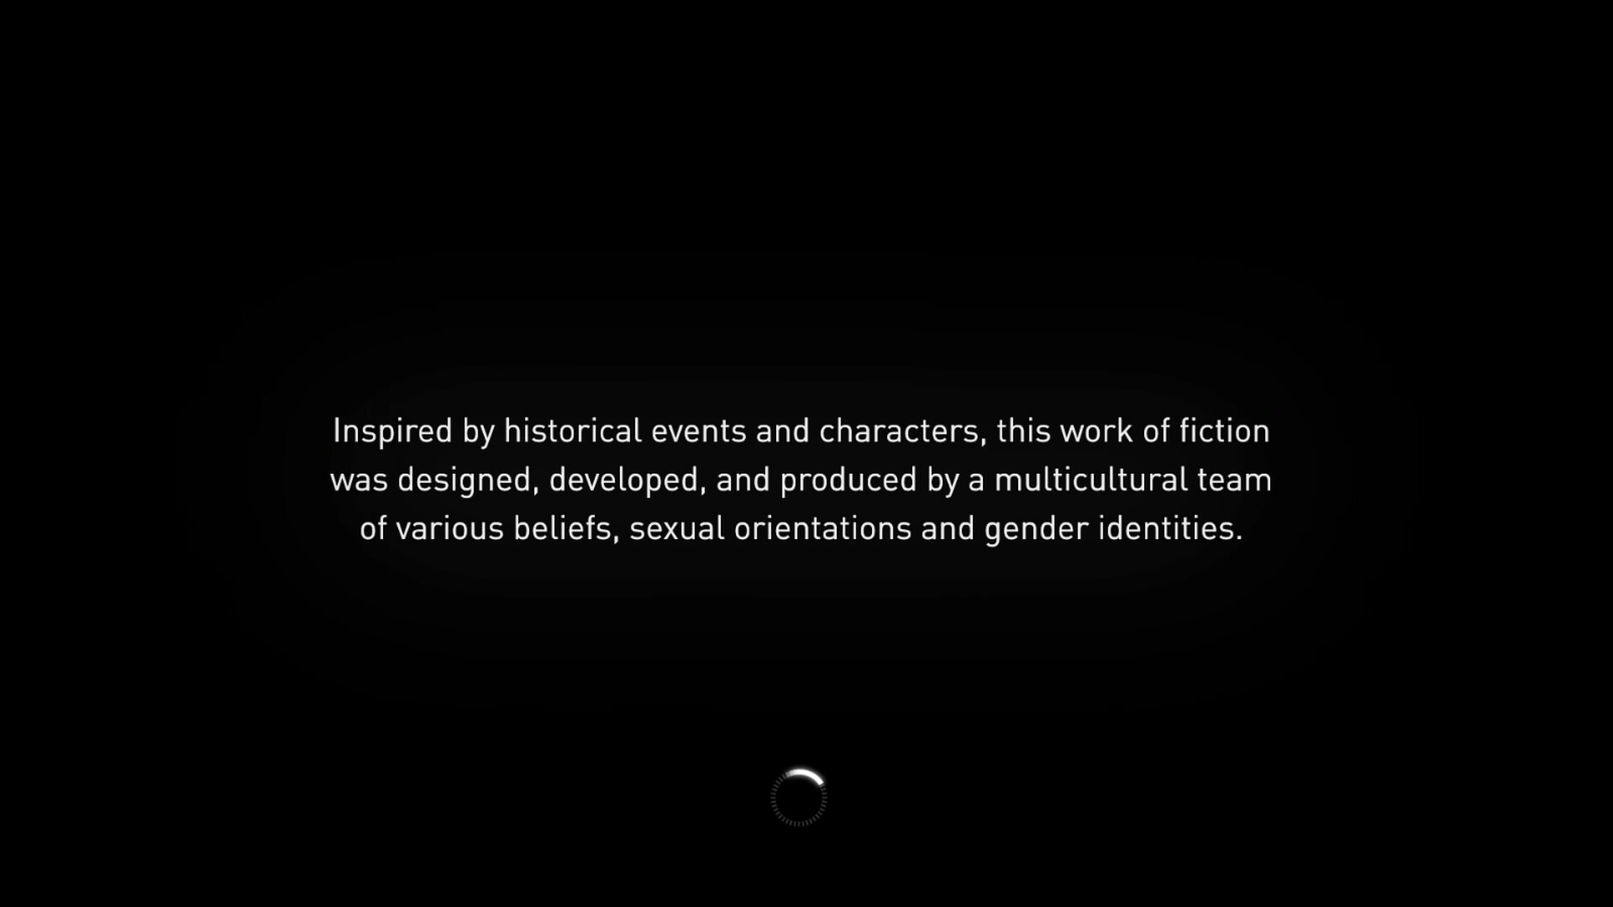


Assassin's Creed
Assassin’s Creed Shadows received criticisms over historical authenticity from some quarters over its main character Yasuke, an African samurai in feudal Japan
Vice President Executive Producer for the series, Marc-Alexis Coté responded to the criticisms:
"We've consistently introduced protagonists from diverse racial, ethnic, and gender identities. History is inherently diverse, and so is Assassin's Creed and the stories we tell. So, to be clear, our commitment to inclusivity is grounded in historical authenticity and respect for diverse perspectives, not driven by modern agendas.“ (Adam, 2024)

Slide 24

‘Who lives in this space?’ Diversity in Games and the Games Industry.

Slide 25
What Does Diversity mean to us?
Over to you…

Slide 26
The Problem
GamerGate –
Started in August 2014 under the guise of ethical scrutiny in Games journalism. Eron Gjoni wrote a blog post about the end of his romantic relationship with game designer, Zoe Quinn; creator of a free game called ‘Depression Quest’. Accusations were made against her that she traded sex in exchange for favourable reviews of her game. Despite evidence existing to counter the allegations, the fact that no games media outlet wanted to cover the story was interpreted as a cover-up, and the discussion become one over corruption in games journalism.
This led to a lot of violent, aggressive messages and posts, targeting not only Quinn but games developer, Brianna Wu, and feminist vlogger, Anita Sarkeesian (Braithwaite, 2016).

Slide 27
The Problem
GamerGate –
Gamergate was a move to ‘preserve’ what was seen as the identity of the ‘gamer’ (stereotypically mid-20s white male), and it became aligned to ideologies popular within the Alt-Right, Red-Pill/ Manosphere, and Incel communities.
GamerGate 2 –
Narrative design studio Sweet Baby Inc found itself in the firing line a decade later, with accusations on Steam and Discord that it was influencing AAA game studios with ‘woke ideology’.
According to MacDonald (2024), a lot of the language and conspiracy theories related to these accusations are very similar to the original GamerGate, with connections to popular alt-right conspiracies such as race replacement and enforced feminism and diversity.

Slide 28
Articles Outside Academia
Several interesting articles have been written for broad (usually non-academic) audiences.
According to Sicart (2009):
Popular - and serve as a useful primer for those in industry
Interesting (they both support his conclusions on the use of virtue ethics).
Limited
Consideration of the game as an ethical system
Consideration of the relation between player in and out of game.

Slide 29
Playing a 'Good' Game: A Philosophical Approach to Understanding the Morality of Games
Ren Reynolds (2002)
Applied three different ethical theories to the playing of GTA III
Virtue Ethics
Deontological (duty ethics)
Consequentialism
Concluded virtue ethics was the most relevant for analysis

Slide 30
Is It Wrong to Play Violent Video Games?
McCormick (2005)
A well-argued account
Based on virtue ethics
Bias? - sought to prove violent video games were unethical
Argues playing violent video games is unethical
Cultivates the wrong sort of character
Sicart (2009) argues against this suggesting:
Players are moral agents
Specific game related virtues (anti-cheating etc.)
Attached to a ludic subject (a separate 'game self')

Slide 31
Computer Game Ethics
Sicart (2009) argues:
Computer Games are Designed Ethical Systems
Players are Moral Beings
Games
Have an ethical dimension
Forcing players into unethical actions
Allowing choice
Game Design, must include a moral dimension.
This goes beyond ethics as a mechanic!
E.g., Fable 2, Star Wars: Knights of the Old Republic.

Slide 32
Ethics of Computer Games According to Virtue Ethics
According to Sicart (2009):
Ethical analsys of many computer games mistakenly considers the player as passive
The player is however a moral being experiencing and interpreting the game
Game systems
Should allow the player to afford ethical values into the game play
experience in a meaningful way
However, some games make excellent use of the reverse:
Force the player to undertake a series of actions which challenge their mortality (e.g. Manhunt).

Slide 33
Ethics of Computer Games According to Virtue Ethics (cont.)
Ethics of a computer game is dependent on:
Players' morality
The virtues they have developed (their phronesis)
Game design
Must foster virtuous players
Create player-subjects
Community
Virtuous ethical norms

Slide 34
Ethics of Computer Games According to Virtue Ethics (cont.)
Limitations of this approach:
Participation both in the game and community is voluntary
Depends on social and economical factors
i.e. community likely to be an elite group (time/technology/knowledge)
Values are dictated by a fraction of the total population
Game mechanics are out of reach - lead by developers
Game community adjusts to the closed framework

Slide 35
Accessibility
A recent survey (Yan et al 2011) suggests an increased interest in accessibility in games
Accessibility problems may include not being able to:
Receive feedback
Determine in-game responses
Provide input using conventional input devices.
Key issues Porter and Kientz (2013):
Incompatability with assistive technologies (on-screen keyboards/custom controllers)
Results also suggest more PC/Linux/Mac gamers than console.
No audio description

Slide 36
Accessibility (cont.)
Porter and Kientz (2013) also investigated how these are considered by industry
Focused on 'low hanging fruit'
Focus on simple features - e.g., colour blind friendly pallets.
Straight forward fixes - e.g., text on screen for hearing impairments
Developer diversity
Increasing diversity leading to more experience with some accessibility issues
Education / Awareness vs conceptual grasp of implications

Slide 37
Accessibility (cont.)
Porter and Kientz (2013)'s industry preconceptions continued:
Pressure to adhere to standards
Needs to come from high up in the organisation (targets for outreach).
Role of middlewear
Some features best implemented in game engines
E.g., Text-to-speech/descriptive audio - game elements are easily tagged but adding the audio would be at a lower level.
Role of OS
Drivers for assistive technology readily available for PC/Mac/Linux
Console level drivers tightly controlled.
Change anticipated as console 'move into the living room'.

Slide 38
Summary
Ethics is a big subject!
Need to be aware:
New technology - unforeseen issues e.g.
Games: Addiction
Social Media: Anxiety, depression, body dismorphia
IEEE/ACM/IDGA
Professional developers need to think ahead
Is this possible?

Slide 39
Summary (cont.)
Issues of ethics around games:
Gambling
Accessibility
Addiction
Gender Representation
Next week:
Ethics of the game play experience

Slide 40
References
Adam, K. (2024) “Assassin's Creed Boss Says Series Is Inherently Diverse, Just Like History” [Online] Available at: https://www.pushsquare.com/news/2024/11/assassins-creed-boss-says-series-is-inherently-diverse-just-like-history [Accessed 20 November 2024]
Braithwaite, A. (2016) “It’s About Ethics in Games Journalism? Gamergaters and Geek Masculinity,” Social Media and Society, 2(4). Available at: https://doi.org/10.1177/2056305116672484.
McDonald, K. (2024) “It’s 10 Years Since Gamergate – the Industry Must Now Stand Up to Far-Right Trolls” The Guardian. Available at: https://www.theguardian.com/games/2024/mar/08/gamergate-trolls-woke-game-consultants [Accessed 19 November 2024]

